Slide 1



TRACER
Tri-action Risk Assessment and Calibration for Execution Routing of Small Language Model Responses
GROUP 7
S R Bopitiya - 24071158
N S I Weerasinghe - 24105235
T W L A Perera - 24101822 Supervised By: Dr. Umanga Pilapitya
Notes:
Good morning/afternoon, We're presenting TRACER, the Tri-Action Risk Assessment and Calibration for Execution Routing of Small Language Model responses. Our research asks whether a calibrated ml model can decide, after the fact, whether to accept, repair, or regenerate that response, more reliably than today's simpler routing methods.

Slide 2

Why Post-Generation Routing Matters
Small language models are practical locally, but reliability varies by task and failure type.
1
SLM produces a response
Raw confidence can be high even when the response is wrong.
2
Estimate three action risks
Some drafts are locally repairable; others need a fresh solution.
3
ACCEPT / REPAIR / REGENERATE
Treating every failure identically can waste valid evidence or preserve flawed reasoning.
Sources: Mahaut et al. (ACL 2024) • Chuang et al. (ICML 2025)
Notes:
Let's start with why this decision happens after generation rather than before. By the time TRACER gets involved, the small language model has already produced its answer, so the question isn't which model should respond, it's what we do with the response we already have. That matters because confidence and correctness aren't the same thing: a model can sound certain and still be wrong. Some wrong answers are easy to fix with a quick correction; others are built on a wrong approach and need a completely new attempt. Treating every failure the same way either throws away usable work or keeps a broken answer alive, which is exactly the gap this research targets.

Slide 3
The Missing Capability Is Calibrated Three-Action Risk
Problem statement
Main research question
Existing cascades can accept or escalate an output, but they do not reliably estimate the residual failure risk after multiple post-generation interventions. A nearly correct draft may be safest to repair; a fundamentally wrong response may require independent regeneration.
Can a calibrated, failure-aware ML routing policy reduce incorrect final responses by selecting among ACCEPT, REPAIR, and REGENERATE compared with binary and fixed-action baselines?
RISK
Probability that the final response after an action is incorrect or fails the objective validator.
REPAIR
One stronger-model correction using the task, SLM draft, and non-gold validator feedback.
REGENERATE
A fresh stronger-model solution produced without the full SLM draft.
Sources: Dou et al. (2026, preprint) • Olausson et al. (ICLR 2024)
Notes:
Today's cascading systems can accept an answer or escalate it to a bigger model, but they can't tell you how risky each follow-up option actually is.
A response that's almost right is often safer to repair than to discard; a response built on the wrong approach is usually safer to regenerate from scratch than to patch.
Our research question is whether a calibrated, failure-aware ML policy can reduce incorrect final answers by choosing intelligently among accept, repair, and regenerate, compared with simpler binary or fixed-action approaches.

Slide 4
Operational Definitions: Risk, Repair, and Regenerate
01
02
03
Risk
Repair
Regenerate
Probability that the final output is incorrect or fails the task-specific validator after the selected action.
One stronger-model correction using task + SLM draft + non-gold validator feedback, while preserving valid content.
The stronger model solves the original task independently; the full SLM draft is withheld to reduce anchoring.
OBJECTIVE CRITERIA
BOUNDARY
DISTINCTION
Code tests
numerical tolerance
One repair attempt
Fresh solution, not draft editing
Sources: Olausson et al. (ICLR 2024) • Arimbur (2026, preprint)
Notes:
Here we have defined these three actions. Risk is the probability that the final answer is still wrong after whichever action we take, this is validated by code and numerical tests rather than a human opinion.
Repair means the stronger model gets one shot at fixing the draft, using the SLM's answer.
Regenerate means the stronger model solves the task completely independently, without seeing the incorrect SLM draft at all, so it isn't anchored to the SLM's mistakes.

Slide 5
Scope and Deliverables
01
In Scope
02
Out of Scope
03
Success Criteria
Two verifiable domains; Qwen3-4B and Gemma 3 4B IT; GPT-4.1; one-shot ACCEPT, REPAIR, and REGENERATE outcomes.
Cost/latency optimisation, RL, RAG, multi-agent debate, fine-tuning, iterative repair, and multiple stronger models.
A reproducible answer to the RQ. A positive result requires statistically supported lower final risk/error than strong baselines.
DELIVERABLES
BOUNDARY
EVIDENCE
Action-outcome dataset
ACRE model
Evaluation report
One correction attempt only
Calibration quality
False acceptance rate
Risk regret
Cross-SLM transfer
Primary scope: 1,000–1,400 examples plus a 250–350 example cross-SLM set.
Notes:
Twelve weeks isn't long for a three-action ML study, so we've deliberately narrowed the scope to keep it achievable.
In scope: two task domains we can verify objectively, two small language models, one fixed stronger model, and a single attempt each at repair and regeneration.
Out of scope: cost or latency optimisation, RL, RAG, multi-agent debate, and any kind of iterative repair loop.
Success means a reproducible answer to our research question, backed by calibration quality, false-acceptance rate, risk regret, and evidence that it transfers across models.

Slide 6
Research Gaps
The gap is specifically calibrated post-generation action risk, not SLM + LLM collaboration in general.
01
02
03
Intervention selection is usually binary
Risk estimates are rarely action-specific
Calibration seldom covers corrective choices
Most cascades accept or defer. Newer systems add resampling or rerouting, but do not jointly learn ACCEPT vs REPAIR vs REGENERATE residual risk.
Confidence methods mostly score the current answer or routing decision, rather than the failure probability after each intervention.
Calibrated routing typically governs accept/defer. Repair studies show repairability varies, but a calibrated selector across corrective actions remains underexplored.
Confidence Tokens
Factual Confidence
Unified Routing
AutoMix
Cluster–Route–Escalate
Resample or Reroute
Conformal Cascade
Arimbur
Olausson et al.
Sources: AutoMix (NeurIPS 2024) • Dekoninck et al. (ICML 2025) • Chuang et al. (ICML 2025) • Moslem et al. (2026, preprint) • Dou et al. (2026, preprint) • Chen (2026, preprint) • Olausson et al. (ICLR 2024) • Arimbur (2026, preprint)
Notes:
There are 3 main research gaps. First, most cascading systems only support a binary choice, accept or escalate, and even newer systems that add resampling or rerouting don't jointly learn the risk of all three actions we care about.
Second, confidence estimation methods generally score the answer you already have, not what would happen if you repaired or regenerated it.
Third, calibrated routing research is almost entirely about accept-or-defer decisions; nobody has really built a calibrated selector across corrective actions like repair versus regenerate.
That gap, calibrated and action-specific, is exactly what TRACER is built to fill.

Slide 7
Literature Comparison
Work
Action space
SLM output?
Repairs draft?
Calibrated?
Remaining gap
AutoMix (2024)
Accept / escalate
Yes
No
No
Binary post-output cascade
Unified Routing (2025)
Route / cascade
Partly
No
Quality est.
Model-selection focus
Confidence Tokens (2025)
Accept / route
Yes
No
Improved conf.
No corrective-action outcome model
Cluster–Route–Escalate (2026)
Accept / escalate
Yes
No
QE classifier
No repair-vs-regenerate choice
Conformal Cascade (2026)
Accept / defer
Yes
No
Yes
Calibrated but binary
Resample or Reroute? (2026)
Resample / reroute
Yes
No
Verifier-gated
Budget actions, not repair
Arimbur / Olausson
Repair / resample studies
Yes
Yes
No selector
Shows repairability varies
TRACER
Accept / repair / regenerate
Yes
Yes
Yes, per action
Action-specific residual risk
Sources: AutoMix (NeurIPS 2024) • Dekoninck et al. (ICML 2025) • Chuang et al. (ICML 2025) • Moslem et al. (2026, preprint) • Dou et al. (2026, preprint) • Chen (2026, preprint) • Olausson et al. (ICLR 2024) • Arimbur (2026, preprint)
Notes:
This table lays out exactly how we compare against the closest prior work. TRACER is the only approach here that uses the SLM's output, actually repairs the draft, supports independent regeneration, and produces a calibrated risk estimate specific to each of the three actions.

Slide 8

Aim, Hypothesis, and Project Goals
Research aim
Hypothesis
Develop and evaluate a calibrated ML model that estimates the residual failure risk of ACCEPT, REPAIR, and REGENERATE, then selects the action with the lowest predicted risk.
A calibrated action-conditional risk model will reduce final incorrect responses and false acceptance compared with binary accept/escalate and fixed-action baselines.
Project goals
G1
G2
G3
Build a reproducible SLM → risk estimator → action pipeline
Create offline action-outcome data for all three actions
Train and calibrate ACRE; compare strong baselines
G4
G5
Evaluate on two objectively verifiable task domains
Answer the research question with reproducible evidence
Notes:
The aim is simply to build and evaluate a calibrated model that estimates failure risk for each action and picks the lowest-risk one.
The hypothesis is that this approach will beat binary accept-or-escalate and fixed-action baselines on both error rate and false acceptance.

Slide 9
Proposed Solution
TRACER uses a learned risk estimator; deterministic validators provide evidence and labels, but do not hard-code the action.
ACCEPT : return SLM response
User task
SLM response
Features
ACRE
Final
response
→
→
query+response embed
→
→
REPAIR : strong model edits draft
→
uncertainty
3 calibrated risk heads
validator signals
REGENERATE : strong model answers fresh
Important: “validator features” are inputs to the ML model, not hard-coded routing rules. Choose lowest calibrated predicted failure risk.
Sources: Chuang et al. (ICML 2025) • Mahaut et al. (ACL 2024) • Arimbur (2026, preprint)
Notes:
This slide presents our proposed solution: TRACER.
The system is built around a learned risk estimator, rather than a fixed set of rules.
The process begins when a user task is passed to the small language model.
The SLM produces a draft response.
From this, we extract a set of features: query and response embeddings, the model's own uncertainty, and validator signals such as whether code compiles.
These features are passed into ACRE, our risk estimator.
ACRE returns three calibrated risk scores, corresponding to accept, repair, and regenerate.
The system then selects the action with the lowest predicted risk. ////
The key thing to emphasise: validator signals act as model inputs, not as hardcoded decision rules.

Slide 10
Methodology
A controlled offline experiment produces labels for every action, then ACRE learns action-specific failure risk.
1
2
3
4
Prepare tasks
Generate action outcomes
Train + calibrate
Evaluate risk control
DebugBench + HumanEval+/MBPP+ and FinQA; task-level 60/20/20 split; objective validators.
For each SLM response: validate ACCEPT; run one strong-model REPAIR; run one independent REGENERATE.
Train three failure-probability heads; compare logistic regression, XGBoost, direct 3-class, uncalibrated MLP.
Compare final incorrect-response rate, false acceptance, Brier/ECE, per-action AUROC, and risk regret vs oracle.
SLM 1 Qwen3-4B-Instruct
SLM 2
Gemma 3 4B IT
Strong model
GPT-4.1
Risk scorer
ACRE: shared MLP + 3 heads
Calibration
Per-head temperature scaling
Domains
Code debugging + financial reasoning
Primary scope: 1,000–1,400 examples; 250–350 cross-SLM examples; one correction attempt only.
Sources: Tian et al., DebugBench (Findings of ACL 2024) • Chen et al., FinQA (EMNLP 2021) • Qwen Team (2025)
Notes:
Our methodology is structured as a controlled offline experiment.
The first stage is task preparation, drawing on two domains: code debugging and financial reasoning.
Second, for every SLM response, we generate all three possible outcomes: accept, repair, and regenerate.
Third, we train and calibrate three separate failure-risk heads.
Fourth, we evaluate performance using error rate, false acceptance, and calibration metrics.
Together, this provides ACRE with reliable, labelled training data.

Slide 11
Risk Scoring Model: ACRE
INPUTS
Query embedding
Accept risk
P(failure | ACCEPT)
SLM response embedding
Shared representation
Dense 256 + ReLU Dropout 0.2 Dense 128 + ReLU
Repair risk
P(failure | REPAIR)
Calibration layer
Per-head temperature scaling on held-out data
Token uncertainty
Regenerate risk
P(failure | REGENERATE)
Validator features
Task features
Decision: select the action with the lowest calibrated predicted failure risk. The risk model is learned; the final argmin is deterministic.
Sources: Mahaut et al. (ACL 2024) • Chuang et al. (ICML 2025) • Dou et al. (2026, preprint)
Notes:
ACRE stands for the Action-Conditional Risk Estimator.
It represents the core machine learning contribution of the project.
Its inputs include the query embedding, the response embedding, and other features.
These inputs pass through a shared network.
Then three separate heads each estimate a failure probability, one per action.
Each head is calibrated independently.
And as mentioned earlier final decision is to select the action with the lowest calibrated risk.
///// Calibration is necessary because a model's raw confidence is not inherently reliable.

Slide 12
Evaluation Plan
Two domains, objective validators, and risk-focused metrics.
DATASETS & VALIDATORS
BASELINES
PRIMARY & SECONDARY METRICS
Code debugging
SLM only
Strong model only
Primary: Final incorrect-response rate
DebugBench: compile • unit tests • runtime result
Risk control: False acceptance rate
Binary confidence accept/escalate
Always repair
Calibration: Brier score + ECE
Financial reasoning
Always regenerate
Direct 3-class classifier
Prediction: Per-action AUROC / F1
FinQA: exact answer • program execution
Policy: Risk regret vs oracle selector
XGBoost action-risk
Uncalibrated ACRE
Success criterion: a rigorous, reproducible answer. A positive result requires statistically supported lower final error and false acceptance than strong baselines, with well-calibrated action risks.
Sources: Tian et al., DebugBench (Findings of ACL 2024) • Chen et al., FinQA (EMNLP 2021) • Olausson et al. (ICLR 2024)
Notes:
Evaluation is conducted across two domains, each with objective validators.
Code debugging is assessed using DebugBench, through compilation and unit tests.
Financial reasoning is assessed using FinQA, through exact-answer verification.
We compare against eight baselines using these primary and secondary metrics shows here.
Lastly, a positive result requires outperforming these baselines with statistically supported, well-calibrated risk estimates.

Slide 13



Why Agile over Waterfall?
AGILE FIT
WATERFALL LIMIT
FEEDBACK NEED
SCOPE CONTROL
Pilot results can change task mix, prompts, validators, and features.
Key assumptions may remain untested until late phases.
Calibration and validator quality need frequent review.
Backlog and sprint goals protect the 12-week boundary.
SELECTED APPROACH AND PM STACK
Agile Scrum
Jira
GitHub
MLflow
One-week feedback loops with a reviewable increment
Sprint board, owners, due dates, dependencies
Issues, branches, pull requests, CI, version history
Experiment runs, metrics, artifacts, reproducibility
Notes:
For project delivery, we adopted Agile Scrum rather than a Waterfall approach.
This research is exploratory in nature, and pilot results may change our task mix, prompts, validators, or features.
A Waterfall structure would lock these decisions in prematurely, before sufficient evidence exists.
We also need ongoing feedback, as calibration and validator quality need frequent review throughout.
Agile's sprint structure also protects our 12-week deadline: a fixed backlog and clear sprint goals stop scope from quietly expanding.
This is supported by a defined toolchain: Jira for sprint planning, GitHub for version control, and MLflow for experiment tracking.
Together, this approach will help us be flexible while keeping track of our project within the timeline.

Slide 14
Project Delivery Approach: Agile Scrum + Jira
The exploratory study runs as 12 one-week sprints with a visible backlog, review, and disciplined scope control.
Backlog
Sprint Planning
Build / Experiment
Review
Retro
Epics + stories
1-week sprint
Daily coordination
Demo + results
Improve process
MAIN EPICS
SCRUM ROLES
Product Owner - Sayuru
Scrum Master - Rotates among members every 3 sprints
Researchers - Lithma, Sulakna, Sayuru
Research & literature
Data + validators
Action-outcome generation
Evaluation
Paper + presentation
ACRE model
Sources: Schwaber & Sutherland, The Scrum Guide (2020)
Notes:
In practice, the project is organised into twelve one-week sprints.
Each sprint follows a consistent cycle: planning from the backlog, building or experimenting, reviewing outcomes, and conducting a retrospective.
The Jira backlog is structured around six epics.
These correspond to the project's major phases: research and literature, data and validators, outcome generation, ACRE development, evaluation, and finally, the paper and presentation.
This structure will assure that our project is coherent, rather than disconnected units of work. Roles are also clearly defined within the team.
Sayuru is the Product Owner, prioritising the backlog and representing the project's direction.
The Scrum Master role rotates every three sprints among all three members, so no one is stuck coordinating the whole project throughout and everyone gets hands-on experience running the process.
All three of us will work as researchers, each owning a workstream while sharing the write-up and analysis part.

Slide 15
Stakeholders & Team Management
STAKEHOLDER MAP
MANAGE CLOSELY
KEEP SATISFIED
Supervisor • 3-person research team
Module lecturer / examiner
KEEP INFORMED
MONITOR
Research peers / future users
External model / API providers
STAKEHOLDERS
Internal Stakeholders
The 3-person research team (Lithma, Sulakna, Sayuru)
Supervisor - directly guides and oversees the project
External Stakeholders
Module lecturer- assesses the project, but isn't involved in doing the work
Research peers - benefit from or are interested in the outcome, not involved in delivery
External model / API providers - third-party services the project depends on, but has no control over
THREE-PERSON WORK ALLOCATION
Researcher A
Datasets, SLM inference, action-outcome generation
Researcher B
Validators, uncertainty features, calibration
Researcher C
ACRE model, routing evaluation, experiment reporting
All members
Literature review, sprint review, paper writing, final analysis
Notes:
Stakeholders were identified and mapped according to the degree of engagement required.
The supervisor and the three-person team require the closest and most frequent contact.
The module lecturer and examiner require visible progress to remain satisfied.
Research peers and future users require only ongoing awareness of progress.
External API providers are monitored rather than actively managed.
Within the team, each researcher is responsible for one workstream: datasets, validators, or the ACRE model.
Literature review, writing, and final analysis remain shared responsibilities across all three members.

Slide 16
Work Breakdown Structure (WBS)
Level 1 work packages map directly to Jira epics
TRACER
1. Research & Design
2. Data & Infrastructure
3. Outcome Generation
4. ACRE Development
5. Evaluation
6. Reporting & Project Management
Literature review
Datasets
SLM outputs
Feature extraction
Baselines
Jira tracking
Scope + RQ
Validators
Repair outputs
Risk heads
Ablations
Paper / report
Experiment protocol
Model serving
Regenerate outputs
Calibration
Risk analysis
Presentation
Sources: PMI, WBS guidance / PMBOK 7th ed.
Notes:
This slide presents our Work Breakdown Structure.
It is intentionally deliverable-oriented in design.
Each Level 1 work package corresponds directly to a Jira epic, ensuring alignment between planning and execution.
The structure follows the project's natural lifecycle, from top to bottom.
This begins with research and design, followed by data and infrastructure, outcome generation, ACRE development, evaluation, and finally reporting part.
This alignment ensures that all project activity is directly reflected in how progress is tracked.

Slide 17
12 One-Week Sprints & Milestones
1
2
3
4
5
6
7
8
9
10
11
12
Literature + scope
Datasets + validators
SLM baselines + logging
Action-outcome generation
ACRE training + calibration
Baselines + ablations
Cross-SLM / error analysis
Paper + demo + presentation
M1
M2
M3
M4
M5
M6
MILESTONE STATUS
M1 · Protocol frozen
M2 · Pilot passed
M3 · Dataset frozen
M4 · ACRE calibrated
M5 · Tests done
M6 · Final ready
Week 2
Week 4
Week 6
Week 8
Week 10
Week 12
Pending
Pending
Pending
Pending
Pending
Pending
Notes:
This is our sprint-by-sprint plan across all twelve weeks. Each column is one sprint, and the coloured bars show exactly which work package is active during which week; the work naturally flows left to right, from literature and setup, through dataset generation and model training, into evaluation and finally the write-up. The six milestones underneath are real evidence gates, not just calendar markers: the protocol freezing in week two, the pilot passing in week four, the dataset itself freezing by week six. If we miss one of these, that's our signal to adjust scope immediately rather than letting it slide.

Slide 18
Risk Assessment
Risk matrix by likelihood and impact, with risks identified across technical, schedule, resource, and stakeholder dimensions.
Low
Medium
High
TECHNICAL
High
S1
T1
T1
Regeneration dominance and class imbalance across actions - Lithma & Sayuru
T2
Validator defects create incorrect training labels - Lithma & Sulakna
T3
Calibration overfits the validation set - Lithma
SCHEDULE
Medium
T3 S2
T2 R1
S1
Scope creep from adding models, domains, or iterative loops - Sayuru
↑ LIKELIHOOD
S2
Milestones slip if pilot findings force feature or validator redesign -
Sayuru
RESOURCE
Low
K1
R1
API or compute limits delay action-outcome generation - Sulakna
STAKEHOLDER
K1
Limited supervisor or examiner availability delays key design decisions
Sulakna & Sayuru
IMPACT →
Sources: PMI, PMBOK Guide 7th ed. (2021), project risk management principles
Notes:
This risk matrix separates likelihood from impact so we can see at a glance which risks need attention first -- the top-right corner is where regeneration dominance and validator or compute risks cluster. We've grouped every risk into four standard categories: technical risks around the model and data, schedule risks around scope, resource risks around compute and API access, and one stakeholder risk around availability for feedback. Nothing here is hidden; each one has an owner and a mitigation on the next slide.

Slide 19
Risk Mitigation Strategies
Preventive Actions
Contingency Plans
Monitoring Approach
Run a 100–150 example pilot in Sprints 3–4 before committing to full-scale generation
If imbalance persists after the pilot, adjust task mix and failure strata before full generation
Weekly sprint review and supervisor update to catch drift early
Stratified task sampling and class weighting to balance action outcomes
If API or compute is disrupted, resume from checkpointed, cached outputs rather than regenerating
Live Jira risk register with an owner and due date on every open risk
Unit-test every validator before any data generation begins
Bootstrap confidence intervals and per-action support reported every evaluation cycle
If calibration overfits, fall back to isotonic regression and report both methods
Lock the MVP scope after Sprint 4; new ideas go to a future-work backlog
Evaluator kept versioned and immutable after data freeze, audited on a sample basis
If feedback requires major rework, absorb it into the next sprint's backlog, not the current one
Fix one strong model and cache outputs to control API and compute cost
Sources: PMI, PMBOK Guide 7th ed. (2021)
Notes:
For each risk we plan three layers of response. Preventive actions reduce the chance a risk occurs at all, like piloting early and unit-testing every validator. Contingency plans are what we actually do if a risk shows up anyway, so we're not improvising under pressure. And the monitoring approach is how we'd notice a problem early enough for either layer to still work, through weekly reviews and a live Jira risk register.

Slide 20
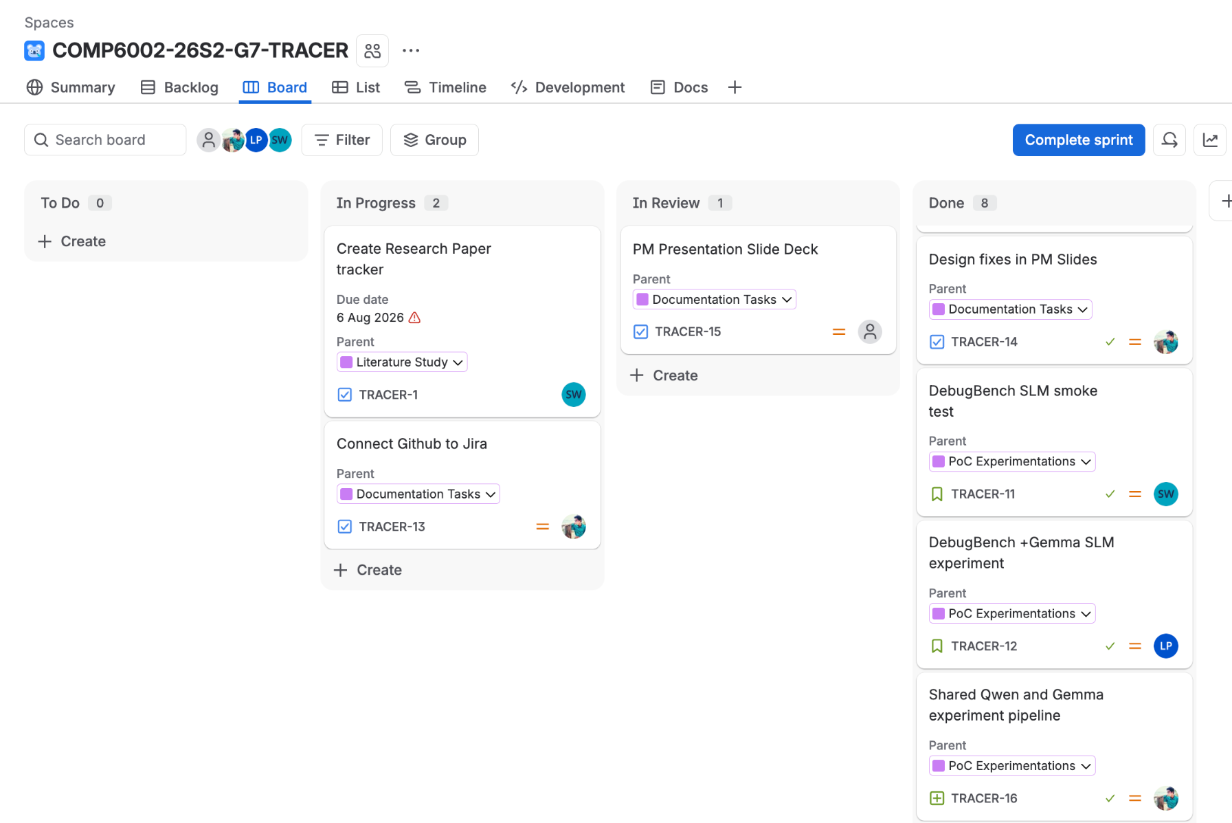
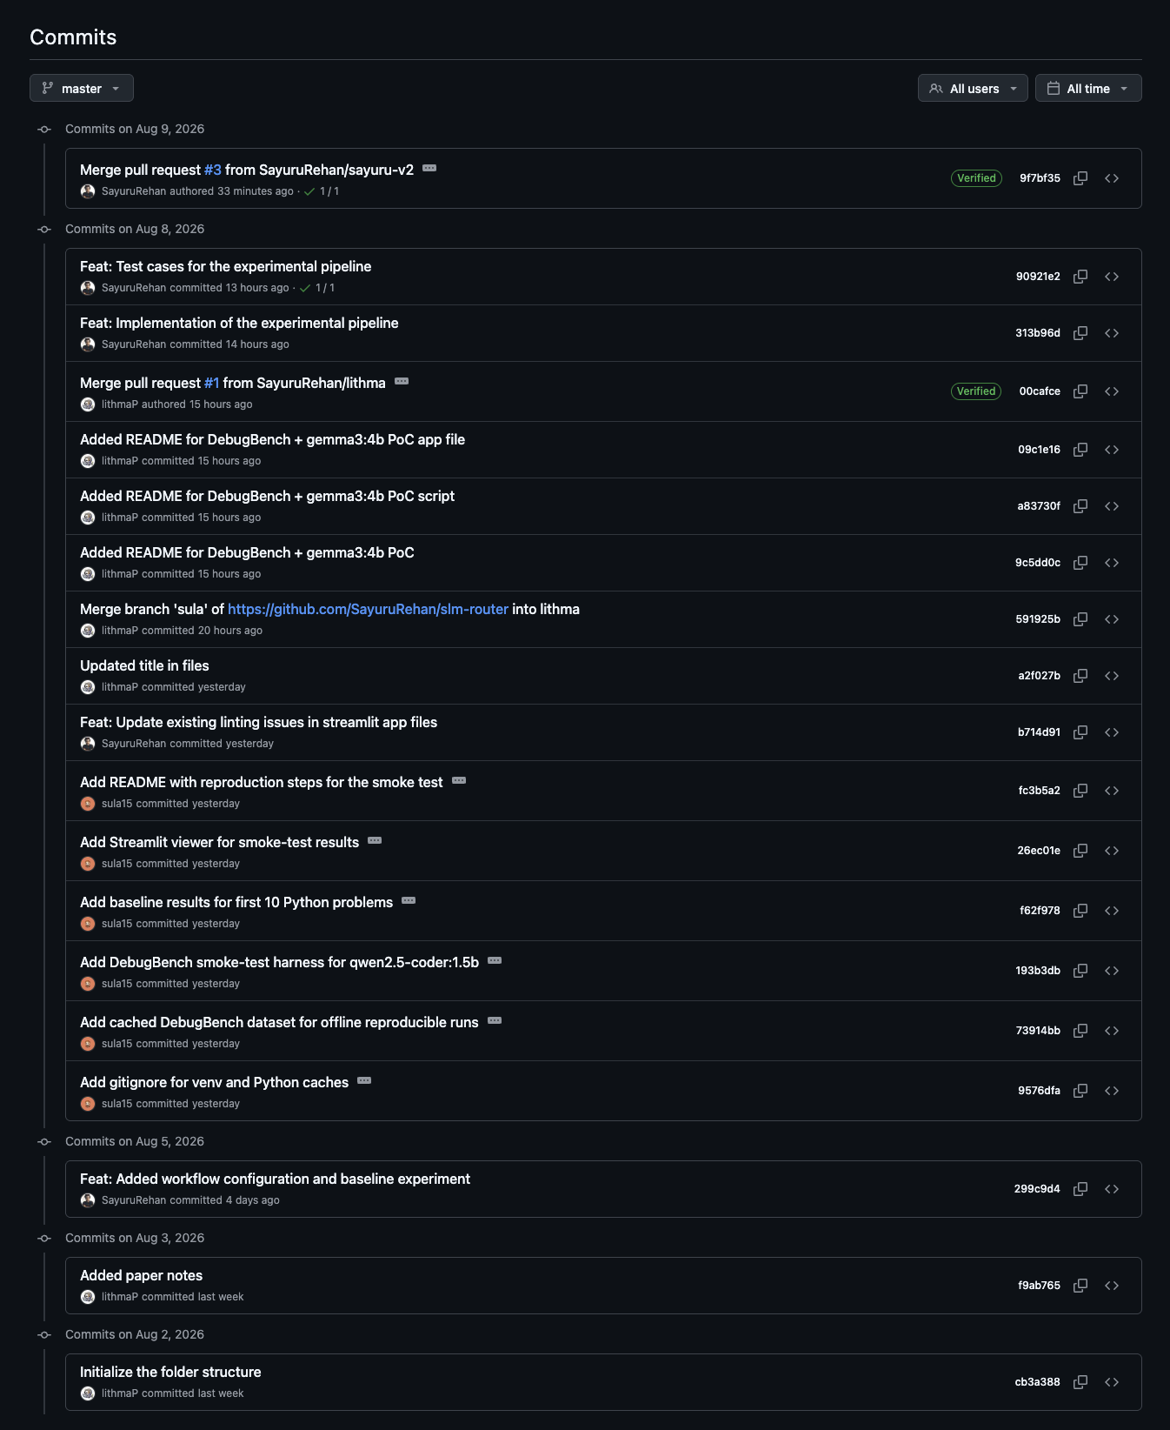
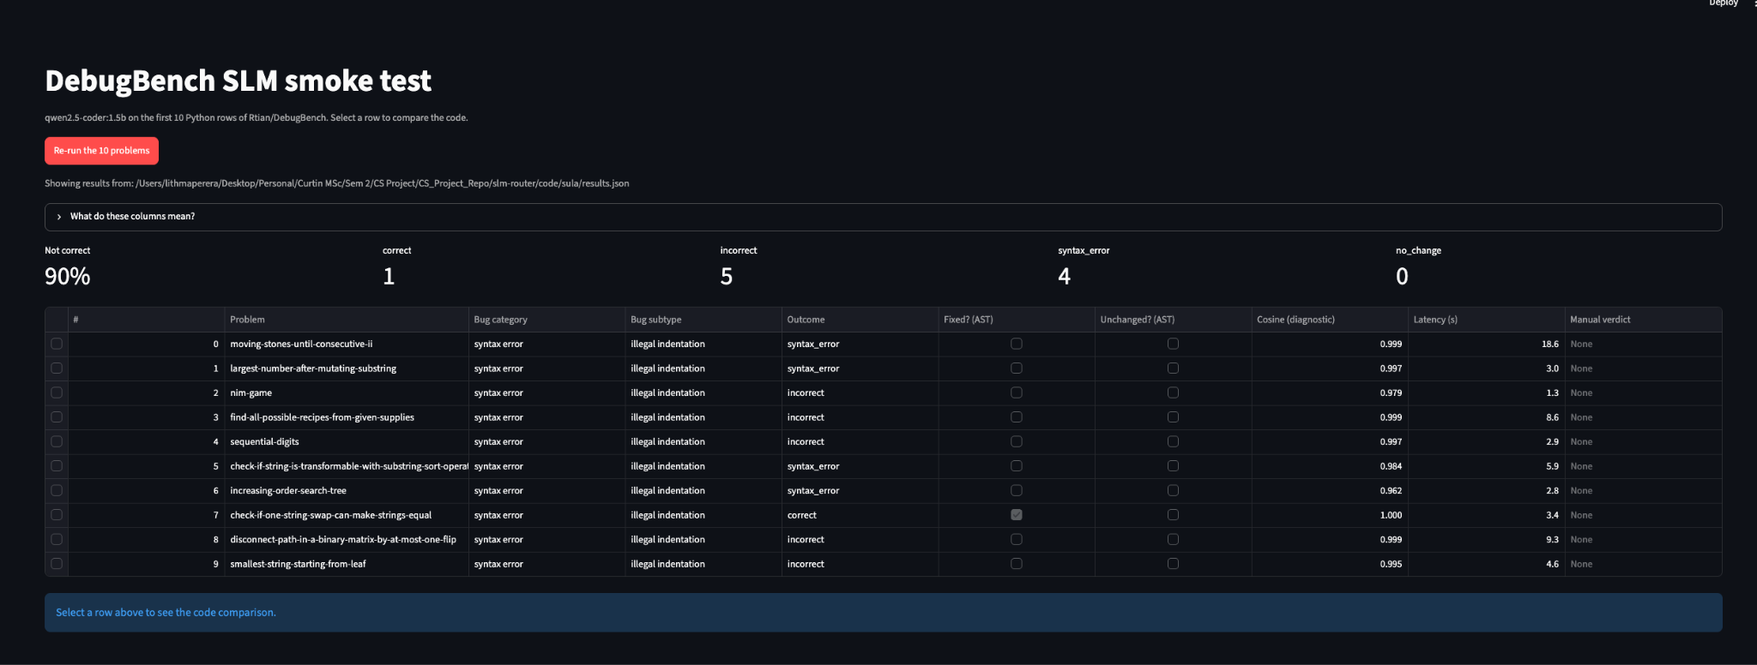
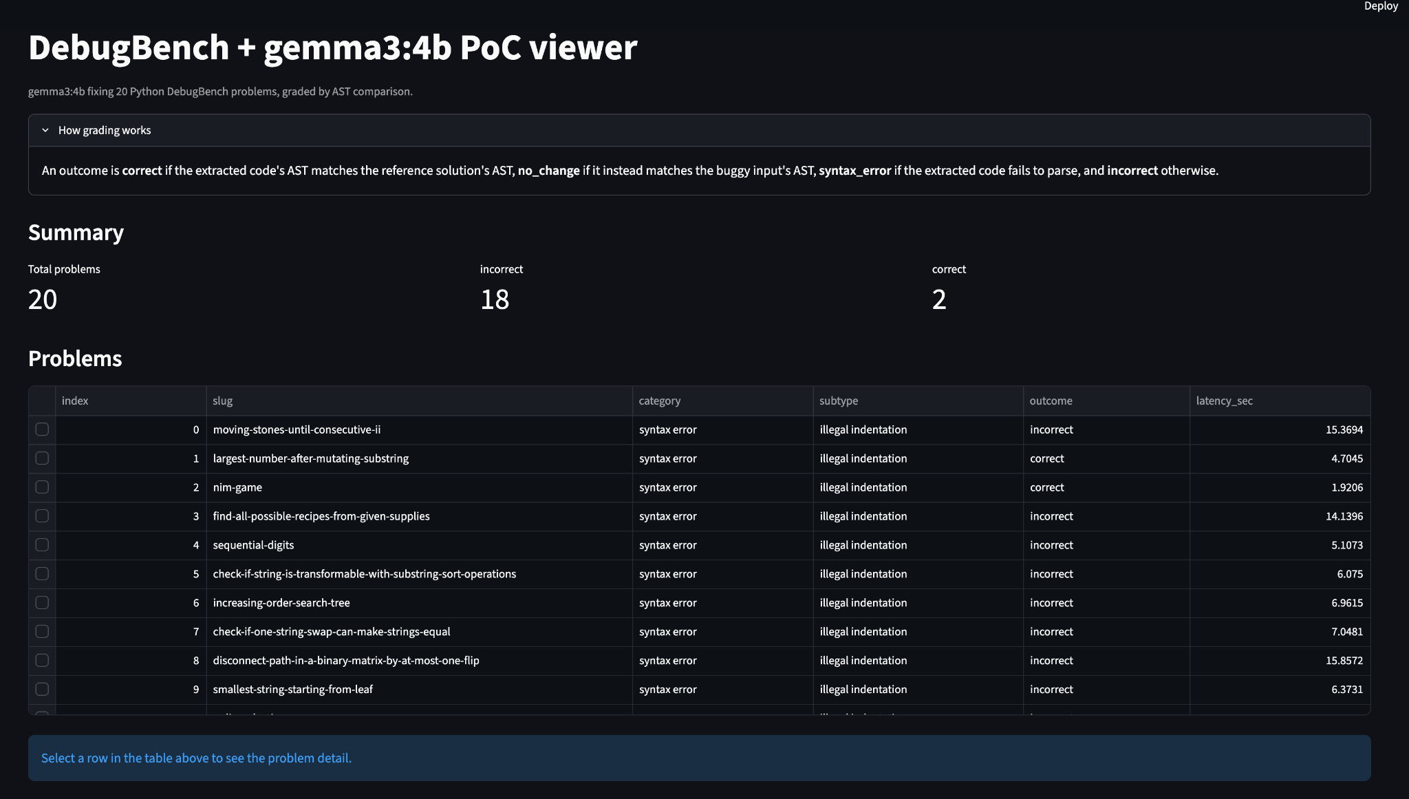
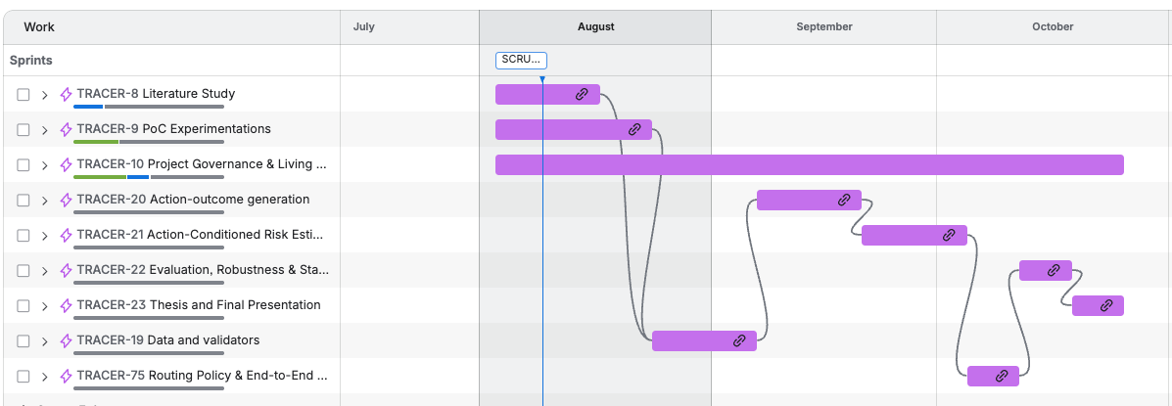
Current Progress / Demonstration
Jira Board
GitHub Commit History
PoC Experiments
Notes:
This slide is where we show live evidence rather than describe it. We are in Sprint 3, with two weeks completed: the Jira board and GitHub commit history are already live, and the third panel shows the proof-of-concept experiments we've run so far -- not a finished prototype yet. Drop the latest screenshots in before each review. The milestone strip below tracks the six evidence gates from our sprint plan and should be updated as each one is actually reached, not just planned.

Slide 21
Expected Outcomes and Definition of Success
Research output
A calibrated three-action risk model (ACRE) and a reproducible action-outcome dataset.
Evidence
Comparison with binary routing, fixed repair/regenerate, logistic regression, XGBoost, and uncalibrated baselines.
Project delivery
12 completed one-week sprints, traceable backlog, versioned code, experiment logs, and final report/presentation.
Definition of success
A rigorous, reproducible answer to the main research question, whether the hypothesis is supported or rejected.
Basis: TRACER research protocol • Scrum Guide (2020)
Notes:
So what does success actually look like at the end of week twelve? Concretely: a calibrated three-action risk model, a labelled action-outcome dataset that didn't exist before, and a clear comparative evaluation against binary routing, fixed-action policies, and standard ML baselines like logistic regression and XGBoost. On the delivery side, that means twelve completed sprints with a traceable backlog, versioned code, and full experiment logs. The most important thing to communicate here is that success isn't defined as the hypothesis being proven right, it's defined as producing a rigorous, defensible answer either way.

Slide 22
Current Progress & Work Ahead
Defined
Planned
Later
Title
Datasets
Local model selection
Research question, Scope
Model roles
Validator implementation
Operational definitions
Validators
100–150 example pilot
Literature gap
Baselines
Implement ACCEPT, REPAIR, REGENERATE
Qwen and Gemma DebugBench PoCs
Risk register
Architecture
12 weekly sprint goals
Train action-specific risk models
Metrics
Evaluation protocol
Calibrate predicted probabilities
Define routing thresholds
Repo setup
Complete final evaluation and dissertation
Baseline Experiment Pipeline
Evidence boundary: the supplied materials document proposal and PM design; they do not yet evidence completed implementation or experiments.
Notes:
We want to be transparent about exactly where we are right now, because it's easy to overstate progress on a proposal like this. What's genuinely defined and locked in: the title, the research question, our operational definitions, the literature gap we're targeting, the scope, the architecture, and our evaluation metrics. What's planned but not yet built: the datasets, model roles, validators, baselines, and the risk register you've just seen. What comes immediately next is repository setup, getting our local models actually serving requests, implementing the validators, and running that pilot. To be direct, nothing has been implemented or tested yet; this proposal is the design, not the results.

Slide 23
Lessons Learned & Challenges
Early design work reduced ambiguity and exposed the experiment's hardest dependencies.
01
02
03
Operational definitions come first
Collect every action outcome
Calibration needs strong baselines
Risk, repair, and regenerate must be labelable before an action-risk model can learn them.
The router needs observed ACCEPT, REPAIR, and REGENERATE outcomes for the same task.
A neural model matters only if it improves on logistic regression, XGBoost, and fixed policies.
CHALLENGE
CHALLENGE
CHALLENGE
Validator correctness and leakage control
API/compute cost and class imbalance
Distribution shift across tasks and SLM families
Sources: Olausson et al. (ICLR 2024) • Arimbur (2026, preprint) • Dou et al. (2026, preprint)
Notes:
Even before writing a line of experiment code, this design phase taught us three things worth sharing. First, you cannot skip straight to modelling; risk, repair, and regenerate had to be nailed down precisely before anything could be labelled, which forced us to think hard about validator correctness and leakage. Second, this only works if we collect every action's outcome for the same task, which raises real cost and class-imbalance concerns we've had to plan around from day one. Third, a calibrated model is worthless without strong, boring baselines to compare against, otherwise we can't prove it's actually adding value.

Slide 24

TRACER turns response handling into a calibrated risk problem.
RESEARCH GAP
Existing work mainly routes before generation or accepts/defers after output; it does not jointly estimate three action outcomes.
CONTRIBUTION
ACRE learns calibrated failure probability for ACCEPT, REPAIR, and REGENERATE from objective action outcomes.
EXECUTION
Two verifiable domains, two SLM families, one stronger model, and 12 one-week sprints.
STATUS
Research design complete; next checkpoint is implementing validators and running the 100–150 example pilot.
Sources: Dekoninck et al. (ICML 2025) • Chuang et al. (ICML 2025) • Olausson et al. (ICLR 2024)
Notes:
To bring this together: today's routing and cascading research mostly stops at accepting or deferring an answer, it doesn't jointly estimate what would happen if you repaired it or regenerated it instead. TRACER's contribution is ACRE, a model that learns calibrated failure probability for all three actions from real, objectively-verified outcomes, not guesswork. We're testing that across two verifiable domains and two different small language model families, and delivering the whole study through twelve disciplined one-week sprints. Where we stand today: the research design is complete and ready to build on, and our very next checkpoint is implementing the validators and running the pilot.

Slide 25
References
1. Chen, L., Zaharia, M., & Zou, J. (2024). FrugalGPT: How to use large language models while reducing cost and improving performance. Transactions on Machine Learning Research.
2. Ding, D., Mallick, A., Wang, C., Sim, R., Mukherjee, S., Ruhle, V., Lakshmanan, L. V. S., & Awadallah, A. H. (2024). Hybrid LLM: Cost-efficient and quality-aware query routing. International Conference on Learning Representations.
3. Aggarwal, P., Madaan, A., Anand, A., Potharaju, S. P., Mishra, S., Zhou, P., Gupta, A., Rajagopal, D., Kappaganthu, K., Yang, Y., Upadhyay, S., Faruqui, M., & Mausam. (2024). AutoMix: Automatically mixing language models. Advances in Neural Information Processing Systems, 37.
4. Ong, I., Almahairi, A., Wu, V., Chiang, W.-L., Wu, T., Gonzalez, J. E., Kadous, M. W., & Stoica, I. (2025). RouteLLM: Learning to route LLMs from preference data. International Conference on Learning Representations.
6. Chuang, Y.-N., Sarma, P. K., Gopalan, P., Boccio, J., Bolouki, S., Hu, X., & Zhou, H. (2025). Learning to route LLMs with confidence tokens. Proceedings of the 42nd International Conference on Machine Learning, 267, 10859–10878.
5. Dekoninck, J., Baader, M., & Vechev, M. (2025). A unified approach to routing and cascading for LLMs. Proceedings of the 42nd International Conference on Machine Learning, 267, 12987–13010.
8. Dou, Y., Fang, S., & Li, S. (2026). Conformal cascade: Distribution-free accuracy guarantees for multi-tier LLM inference. arXiv:2607.25018. [Not peer-reviewed]
7. Mahaut, M., Aina, L., Czarnowska, P., Hardalov, M., Müller, T., & Màrquez, L. (2024). Factual confidence of LLMs: On reliability and robustness of current estimators. Proceedings of ACL 2024, 4554–4570.
10. Chen, T.-R. (2026). Resample or reroute? Budget-aware test-time model selection for large language models. arXiv:2607.08665. [Not peer-reviewed]
9. Moslem, Y., Kacmajor, M., Nedumpozhimana, V., Abbas, A., Panahi, S., Lynch, D., Nie, Z., Agapitos, A., Milenovic, A., Song, H., Shi, Y., Pan, Y., Buffini, P., & Kelleher, J. D. (2026). Cluster, route, escalate: Cascaded framework for cost-aware LLM serving. arXiv:2606.27457. [Not peer-reviewed]
12. Li, H., Zhang, Y., Guo, Z., Wang, C., Tang, S., Zhang, Q., Chen, Y., Qi, B., Ye, P., Bai, L., Wang, Z., & Hu, S. (2026). LLMRouterBench: A massive benchmark and unified framework for LLM routing. arXiv:2601.07206. [Not peer-reviewed]
11. Wu, H., Manoharan, S., Tu, F., Zhao, J., & Wan, J. (2026). RLM-Cascade: Response-level speculative decoding for cost-efficient LLM API serving. arXiv:2606.22840. [Not peer-reviewed]
14. Huang, J., Chen, X., Mishra, S., Zheng, H. S., Yu, A. W., Song, X., & Zhou, D. (2024). Large language models cannot self-correct reasoning yet. International Conference on Learning Representations.
13. Gou, Z., Shao, Z., Gong, Y., Shen, Y., Yang, Y., Duan, N., & Chen, W. (2024). CRITIC: Large language models can self-correct with tool-interactive critiquing. International Conference on Learning Representations.
16. Olausson, T. X., Inala, J. P., Wang, C., Gao, J., & Solar-Lezama, A. (2024). Is self-repair a silver bullet for code generation? International Conference on Learning Representations.
15. Zhang, Y., Khalifa, M., Logeswaran, L., Kim, J., Lee, M., Lee, H., & Wang, L. (2024). Small language models need strong verifiers to self-correct reasoning. Findings of ACL 2024, 15790–15801.
18. Tian, R., Ye, Y., Qin, Y., Cong, X., Lin, Y., Pan, Y., Wu, Y., Haotian, H., Weichuan, L., Liu, Z., & Sun, M. (2024). DebugBench: Evaluating debugging capability of large language models. Findings of ACL 2024, 4173–4198.
17. Arimbur, J. J. (2026). How many tries does it take? Iterative self-repair in LLM code generation across model scales and benchmarks. arXiv:2604.10508. [Not peer-reviewed]
20. Chen, Z., Chen, W., Smiley, C., Shah, S., Borova, I., Langdon, D., Moussa, R., Beane, M., Huang, T.-H., Routledge, B., & Wang, W. Y. (2021). FinQA: A dataset of numerical reasoning over financial data. Proceedings of EMNLP 2021, 3697–3711.
19. Liu, J., Xia, C. S., Wang, Y., & Zhang, L. (2023). Is your code generated by ChatGPT really correct? Rigorous evaluation of large language models for code generation. Advances in Neural Information Processing Systems, 36.
21. Zhu, F., Lei, W., Huang, Y., Wang, C., Zhang, S., Lv, J., Feng, F., & Chua, T.-S. (2021). TAT-QA: A question answering benchmark on a hybrid of tabular and textual content in finance. Proceedings of ACL-IJCNLP 2021, 3277–3287.
22. Yang, A., Li, A., Yang, B., Zhang, B., Hui, B., Zheng, B., Yu, B., Gao, C., Huang, C., Lv, C., Zheng, C., et al. (2025). Qwen3 technical report. arXiv:2505.09388. [Not peer-reviewed]
24. OpenAI. (2025, April 14). Introducing GPT-4.1 in the API. [Not peer-reviewed]
23. Gemma Team. (2025). Gemma 3 technical report. arXiv:2503.19786. [Not peer-reviewed]
25. Reimers, N., & Gurevych, I. (2019). Sentence-BERT: Sentence embeddings using Siamese BERT-networks. Proceedings of EMNLP-IJCNLP 2019, 3982–3992.
Notes:
This first block covers the routing, cascading, and confidence-estimation literature our problem statement builds on. It's here for the written record and for anyone who wants to trace a specific claim back to its source; no need to read it aloud during the talk.

Slide 26

Q & A
Notes:
That's our proposal. We'd like to thank our supervisor and the examiner for their time today, and we're happy to take questions, particularly on the scope decisions, the ACRE model, or the sprint plan.

